Slide 1
Energy Load Forecasting

Slide 2
Background:
Energy companies such as SDG&E provide energy to the consumers in the market.
Providing this energy comes with a cost to the company in a couple ways.
Initial cost to provide the energy needed
Possible loss in selling back unused energy
Possible cost increase to buy immediate energy when there is a shortage
To minimize this cost, companies use different forecasting techniques to predict future load and buy future energy for a lower price.

Slide 3
Purpose:
Use machine learning techniques to forecast future SDG&E energy loads based on future weather conditions.
Provide a place for users to input future weather conditions and see the predicted load given those conditions.
Ultimate Goal:
Expand to multiple companies
Use weather API’s to bring in future weather forecast for automated load prediction

Slide 4
Process:
Gather historical SDG&E load data
Gather historical weather conditions for SDG&E market
Clean and join data
Use TimeSeriesSplit to split data into multiple train/test splits
Use RandomForrest on the splits to build model
Saved model to be used for future projections
Build interface for user input of weather conditions

Slide 5
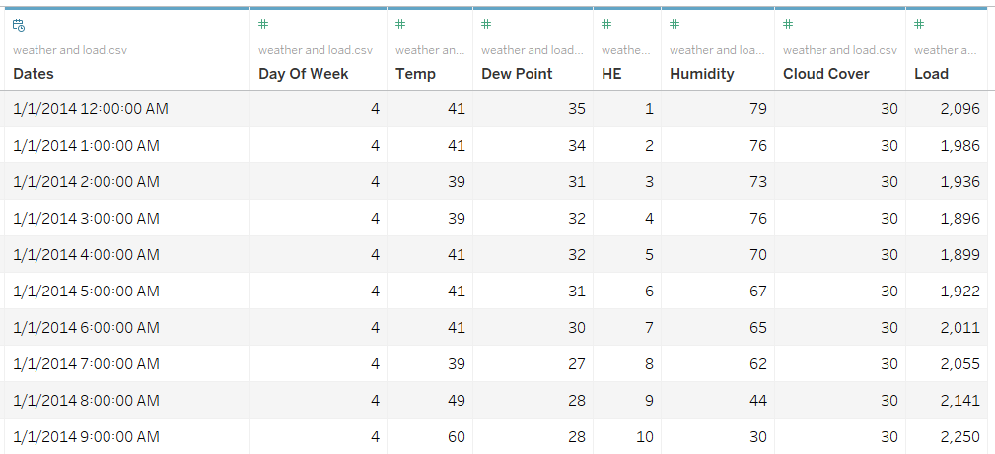
Data:
Dates = Hourly 2014 – 2018
Temp = Degrees F
Dew Point
Humidity
Cloud Cover
Load

Slide 6
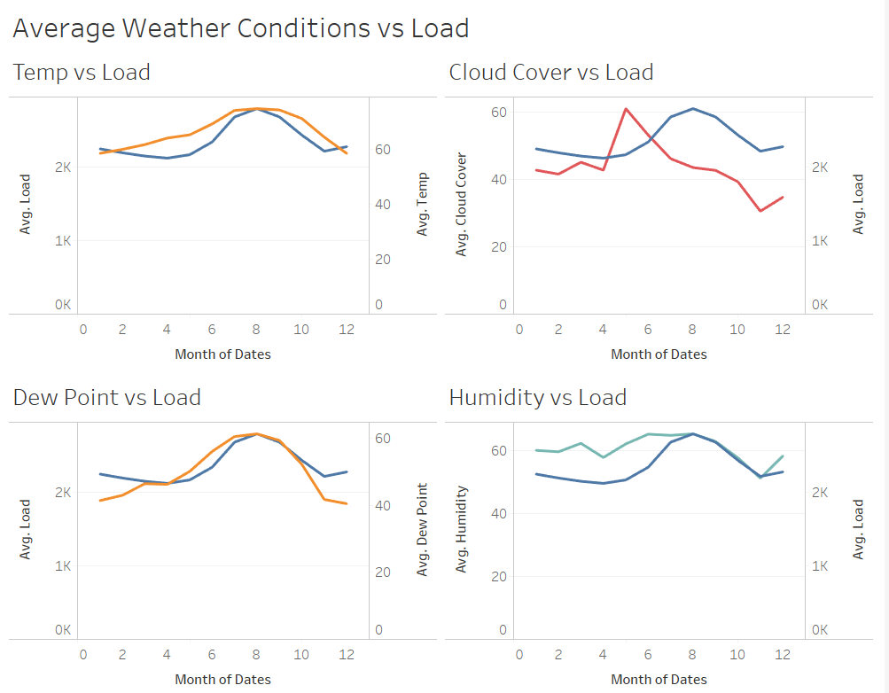
Conditions vs Load

Slide 7
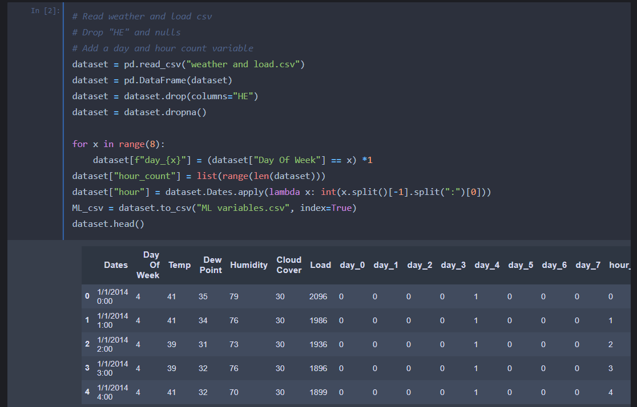
Code:

Slide 8
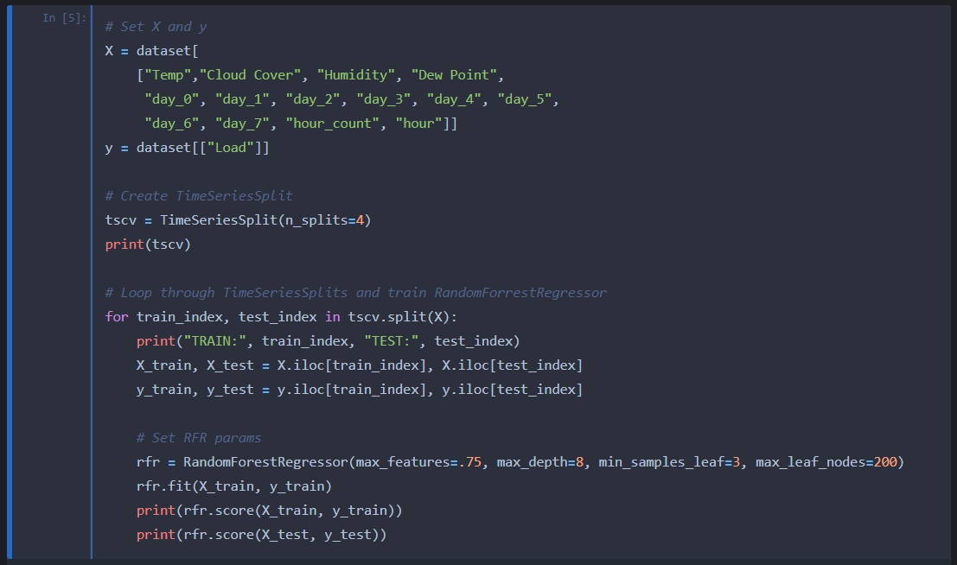
Code:

Slide 9
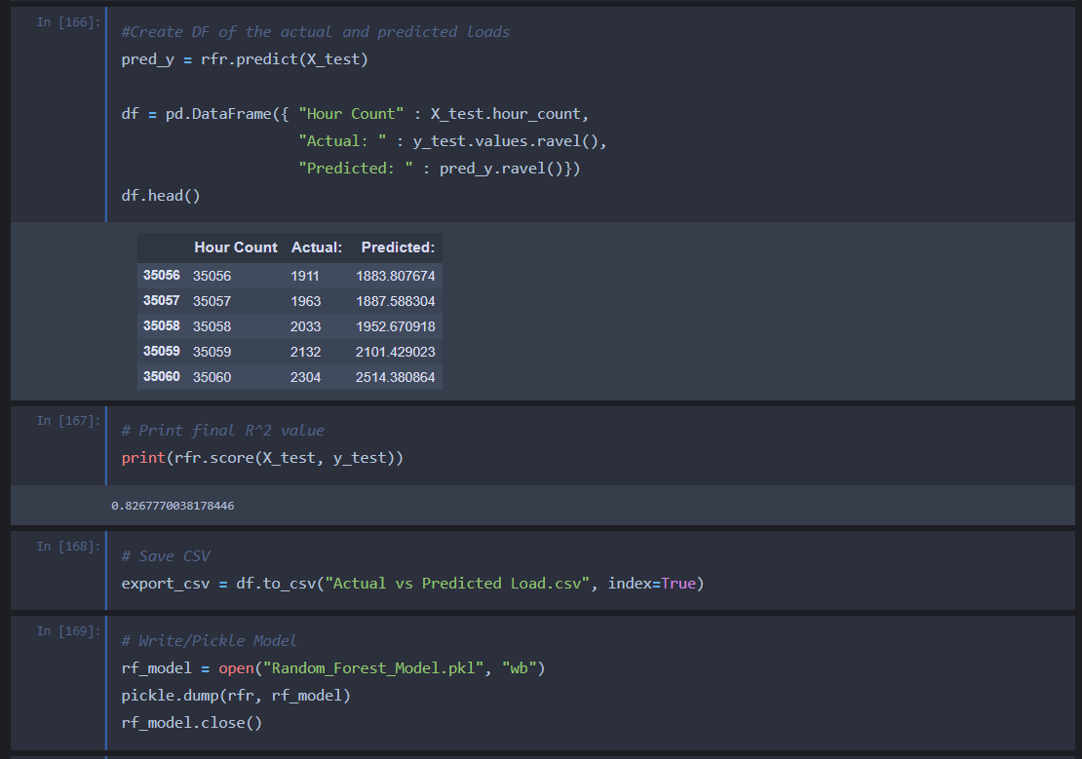
Code:

Slide 10
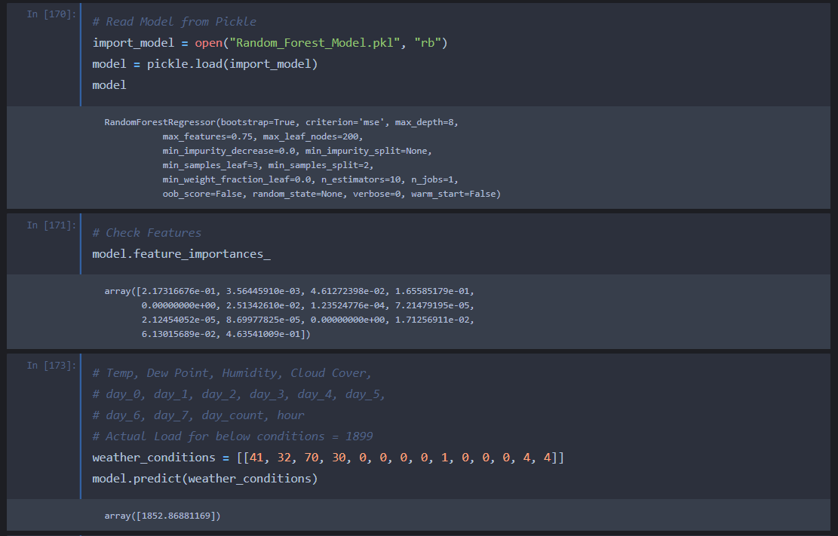
Code:

Slide 11
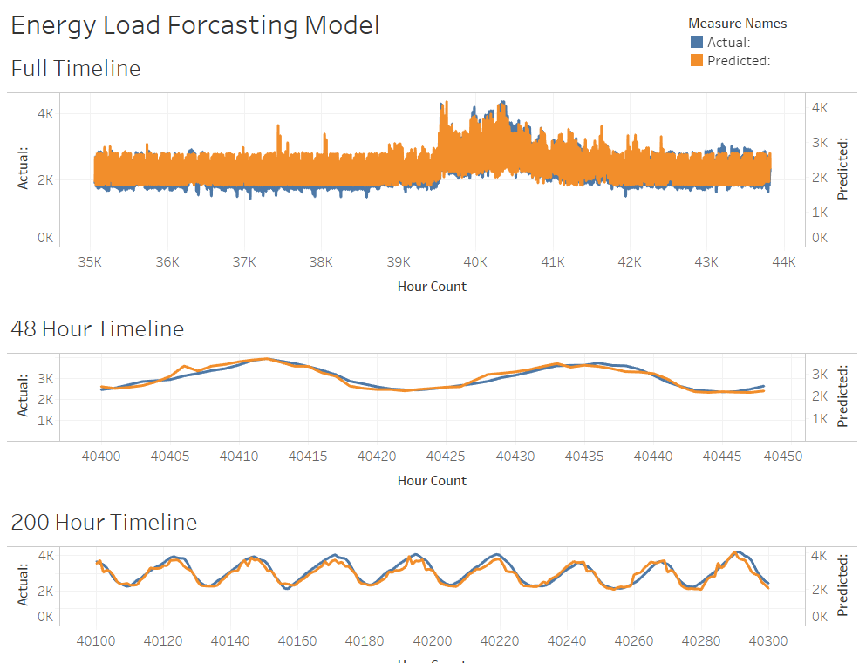
Model Predictions

Slide 12
App…

